Slide 1
Prediction of Airline Passenger Satisfaction using Classification Models
Done By:
Nisreen Alsayegh & Eman Alshehri

Slide 2
OUTLINE
Introduction
Tools
Workflow
Data
EDA-Analysis
Models
Conclusion

Slide 3
Introduction
In this project, we are going to work on a dataset contains an airline passenger satisfaction survey .
The aim of this project is to build a classification models to predict passenger satisfaction and identify which model is outperformed based on accuracy.
Goals
Build a classification models to predict passenger satisfaction.
Choose the model that give us the best predict.

Slide 4





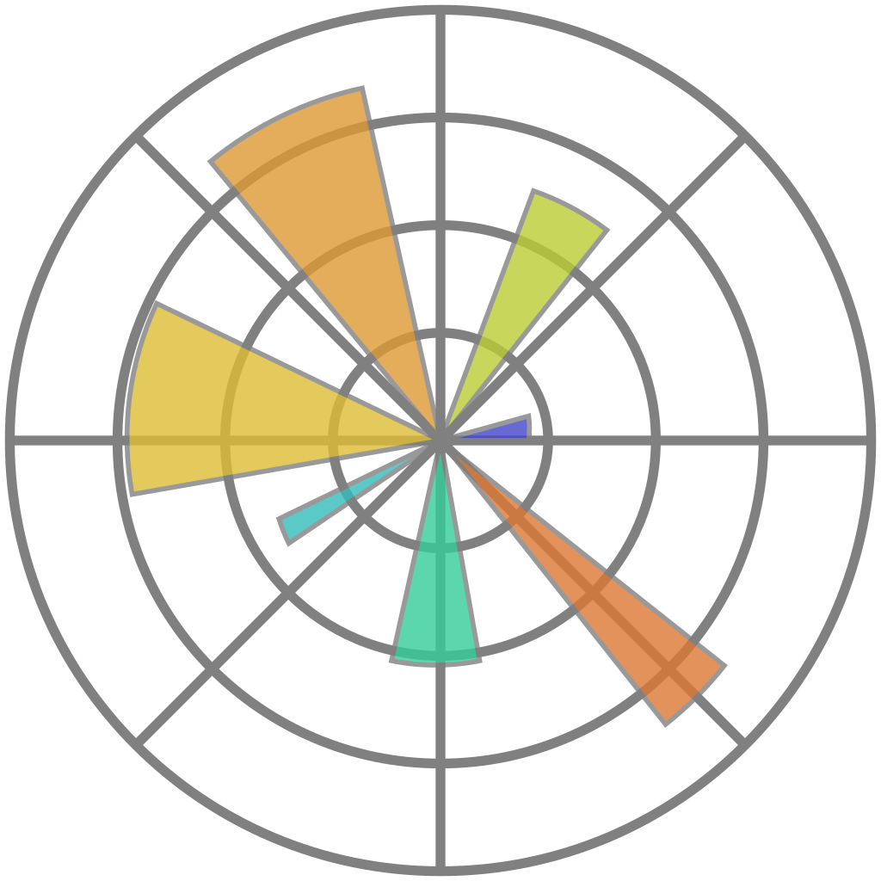

TOOLS:
Jupyter
Seaborn
Pandas
mlxtend
Matplotlib
Scikit-Learn
Numpy

Slide 5
Workflow
Loading
Data
EDA
Building Models
Choosing the best Model

Slide 6
Data Description:
We used the dataset from https://www.kaggle.com
The dataset contains 129880 rows and 25 columns
Cleaning Data :
By removing Null ,outliers and unwanted columns .
The data Becomes :116885 Rows , 23 columns
Convert some numerical data in to categorical.
Convert categorical data to dummies:
Before :116885 Rows , 23 columns
After :116885 Rows , 28 columns
Removing unwanted columns .
Before :116885 Rows , 28 columns
After :116885 Rows , 25 columns

Slide 7
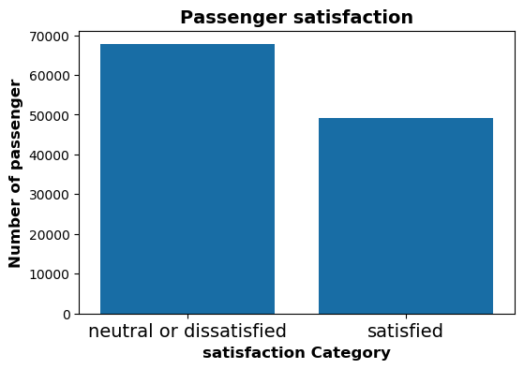
EDA - Analysis
68330
50874

Slide 8
Data Splitting :
Models:
After Grid Search for the best hyperparameters
After tuning the hyperparameters manually
 | KNN Model | Logistic Regression | Decision Tree | Random Forest
Training | 100.00% | 89.99% | 95.46% | 100.00%
validation | 92.93% | 89.07% | 94.54% | 95.83%
 | XGBoosting | Naive Bayes | SVM Model | Gradient Boosting
Training | 99.95% | 88.24% | 95.79% | 100.00%
validation | 95.83% | 86.91% | 94.94% | 95.81%
Training 90 %
Validation
5%
Testing
5%

Slide 9
Models:
After feature engineering
 | Polynomial Random Forest D=2 | Polynomial Random Forest D=3 | Polynomial XGBClassifier D=2 | Polynomial XGBClassifier D=3
Training | 100.00% | 100.00% | 100.00% | 100.00%
validation | 96.10% | 95.91% | 95.91% | 95.89%

Slide 10
0.9594525235243798
Ensemble:
Random
Forest D=3
XGB
D=3
Random
Forest D=2
XGB
D=2
Max Voting
Ensemble
95.84 %

Slide 11
0.9594525235243798
Stacking Classifier :
Random
Forest D=3
XGB
D=3
Random
Forest D=2
XGB
D=2
Ensemble
Logistic
Regression
95.89 %

Slide 12
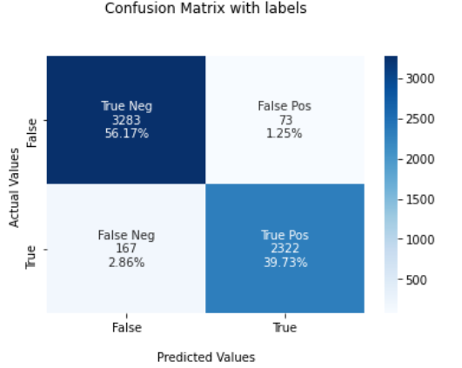
96.01%
Testing our best model:
Random forest classifier D=2
Train
validation
+
fit
Predict
Test
95.93%

Slide 13
Conclusion
After building different models, Polynomial Random Forest degree=2 has the highest score in validation stage.

Slide 14
Future work:
Collect more data
Explore different models

Slide 15
THANK YOU

